Slide 1
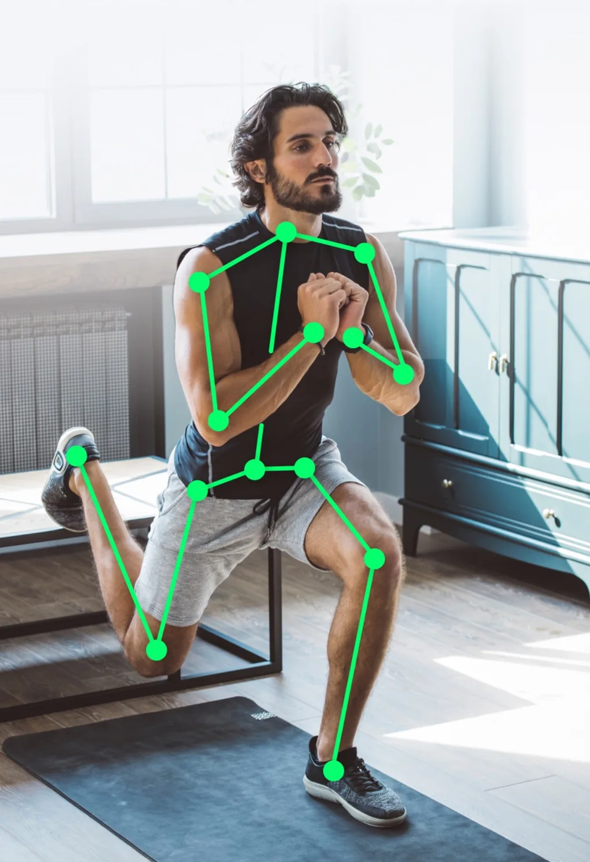
PERSONAL AI TRAINER
Computer Vision
Project

Slide 2
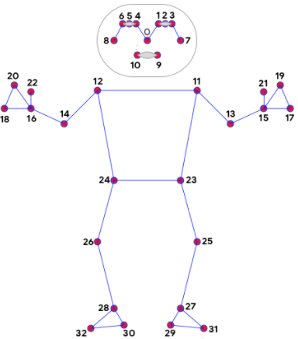
Idea
A personal trainer powered by AI
Workout assistance
Detect and Estimate the posture
Measure accuracy
Count the number of reps

Slide 3
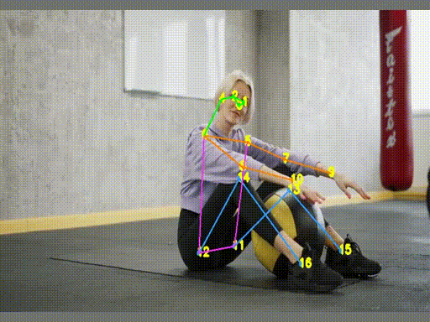
Methodology
Modules to be used:
cv2
MediaPipe
NumPy
Four steps:
Make Detections
Determine Joints
Calculate Angles
Count no. of reps
Pose estimation to label the correct points/landmarks
Using these points, find the desired angles between any three points i.e. two lines
Based on angles, determine various postures & gestures including the number of reps
Apply to other genres as well e.g. Yoga, Pilates etc.

Slide 4
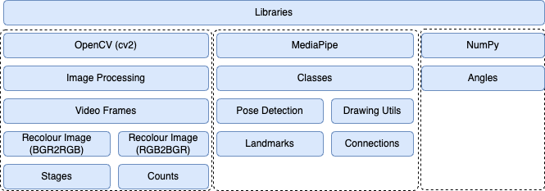
System Architecture

Slide 5

Libraries
cv2 : OpenCV library for image and video processing
MediaPipe : Machine learning solutions for pose estimation, face detection, hand tracking etc.
NumPy : Used for numerical computations

Slide 6
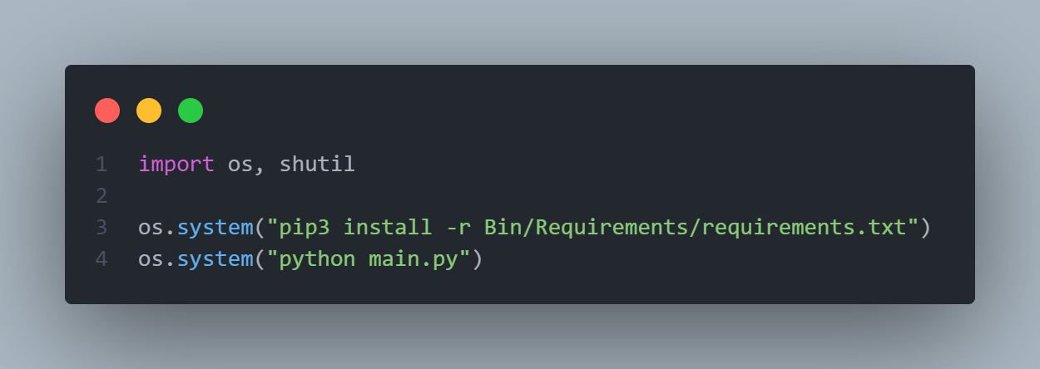
Dependencies installation
File Name: _pre.py
Bin > Requirements > requirments.txt – all dependencies listed
Initiates the execution of the main.py script using the python interpreter.

Slide 7
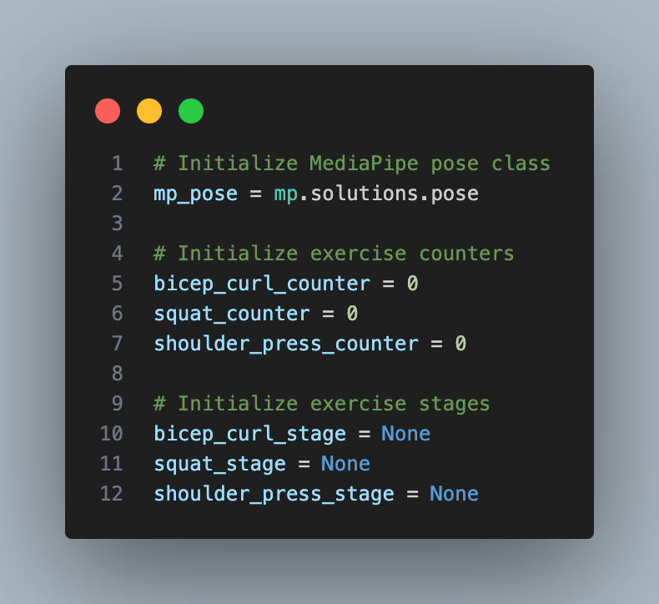
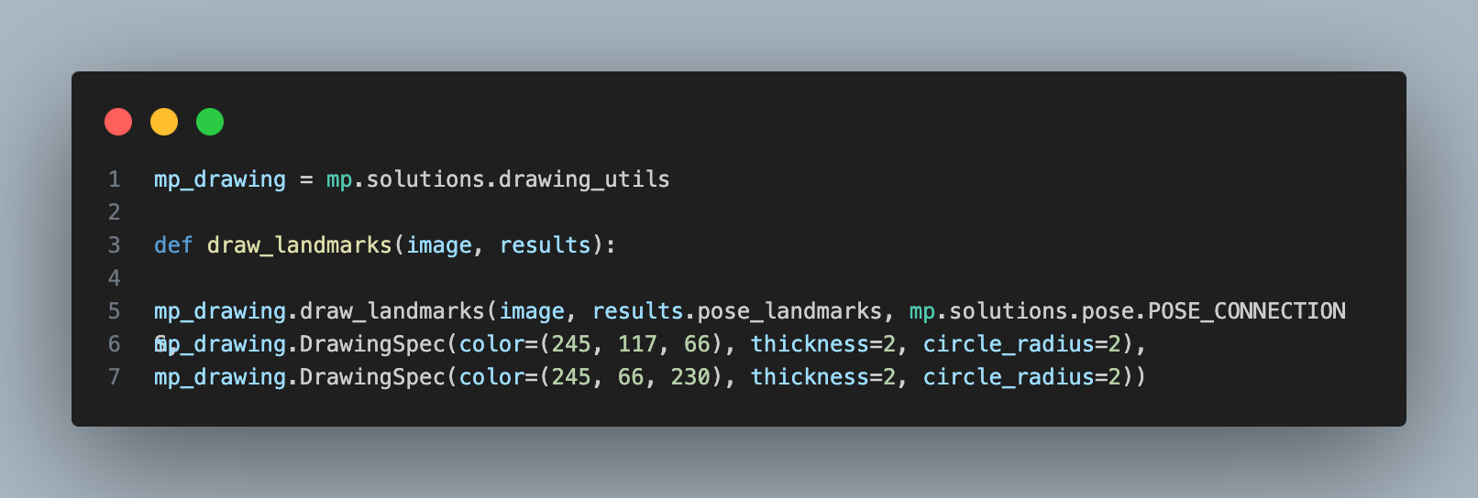
Classes & Utilities
File Name: main.py, lib > visual.py
Initialize MediaPipe pose class
Initialize counters to track # of reps
Initialize stages to track the current phase ("up" or "down")
Drawing utilities to detect & visualize poses

Slide 8
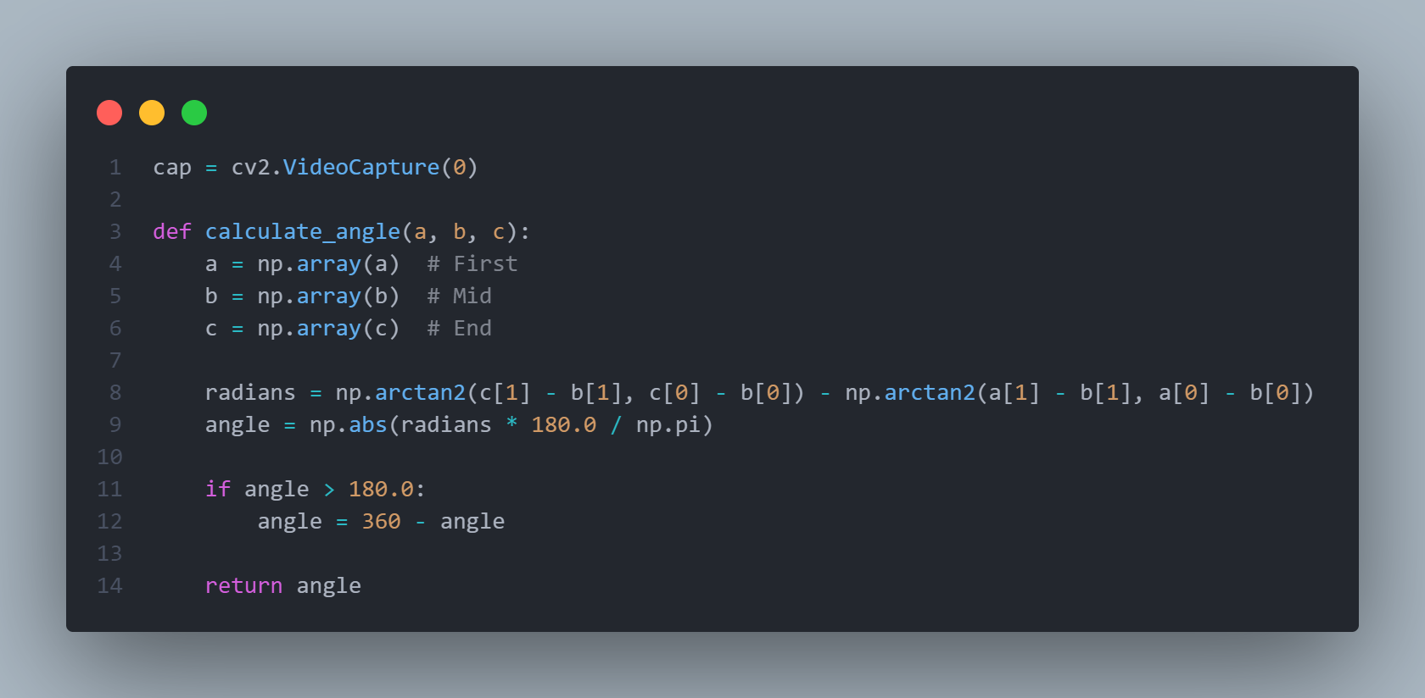
Real-time Angle Calculation
File Name: lib > module.py
Initialize a video capture object (cap) that captures frames from default camera.
Compute the angle between three points (a, b, c) in 2D plane using NumPy
Compute the angle between vectors b->c &
b->a using the Arctan function
Convert the angle from radians to degrees.
Ensure the angle is within the range [0, 180] degrees by adjusting if necessary.

Slide 9
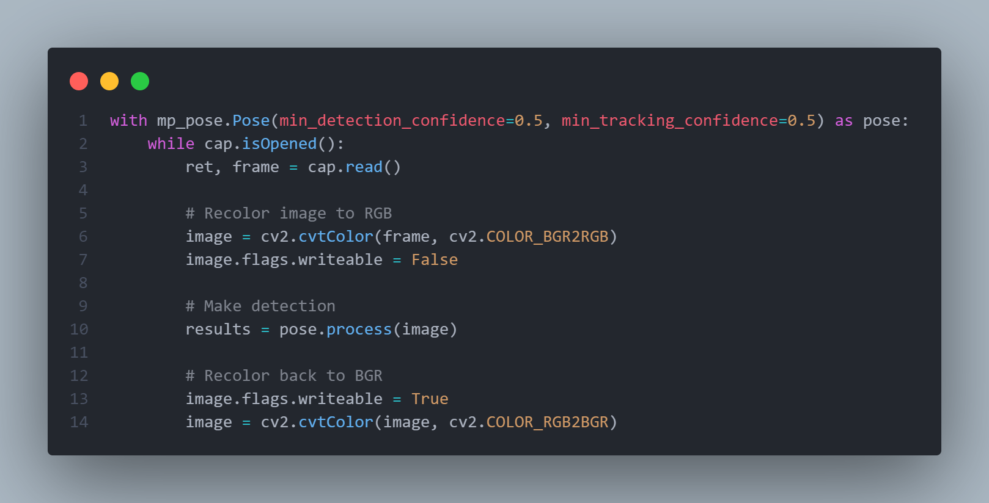
Pose Detection and Processing
File Name: main.py
Initialize a pose detection model from MediaPipe
Set the thresholds for min. confidence (0.5) required to detect and track poses
cvtColor converts BGR frame to RGB format, as required by MediaPipe
Make the image data non-writable for faster processing
Perform pose detection on converted RGB image using the initialized pose model
Make the image data writable again for subsequent processing
Convert the RGB image back to BGR format

Slide 10
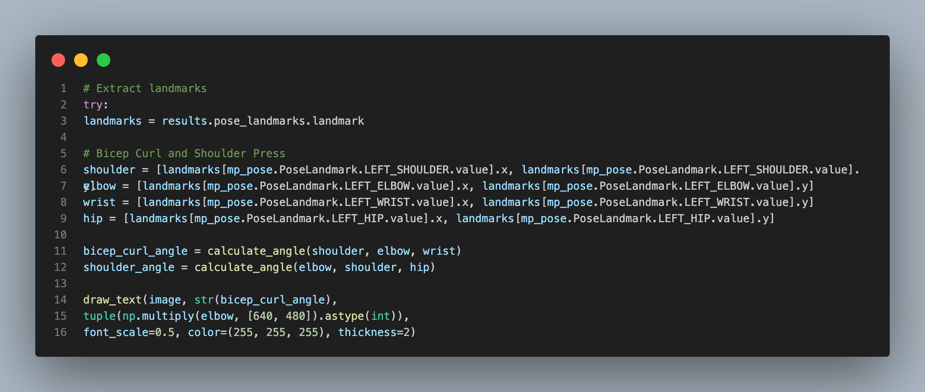
Extract Landmarks
File Name: main.py
Extract coordinates of landmarks – x,y,z (e.g. shoulder, elbow, wrist, and hip)
Calculate bicep curl angle (Between Shoulder, Elbow & Wrist)
Calculate shoulder press angle (Between Elbow, Shoulder & Hip)
Display the calculated angle on the video feed at the position of the elbow joint
Tuple converts the normalized elbow coordinates (0 to 1) to pixel coordinates

Slide 11
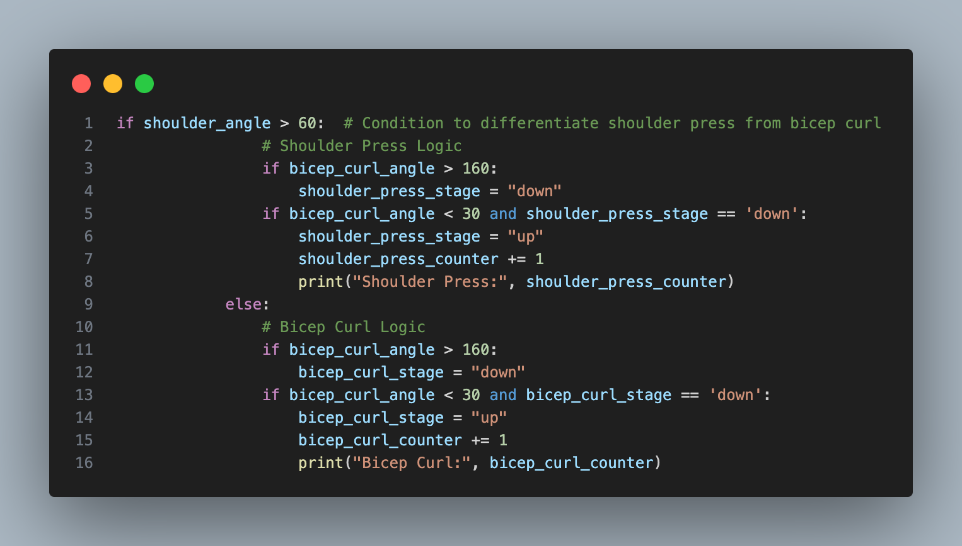
Shoulder Press & Bicep Curl
File Name: main.py
Shoulder angle (> 60 degrees) distinguishes between a shoulder press and a bicep curl
Shoulder Press count:
Count a repetition when the elbow goes from nearly fully extended (> 160 degrees) to fully flexed (< 30 degrees)
Bicep Curl count:
Count a repetition when the elbow goes from nearly fully extended (> 160 degrees) to fully flexed (< 30 degrees)
Stages:
Track the current stage ("down" or "up") to determine when a full repetition is completed
This logic ensures accurate counting of repetitions by monitoring the angles at elbow & shoulder

Slide 12
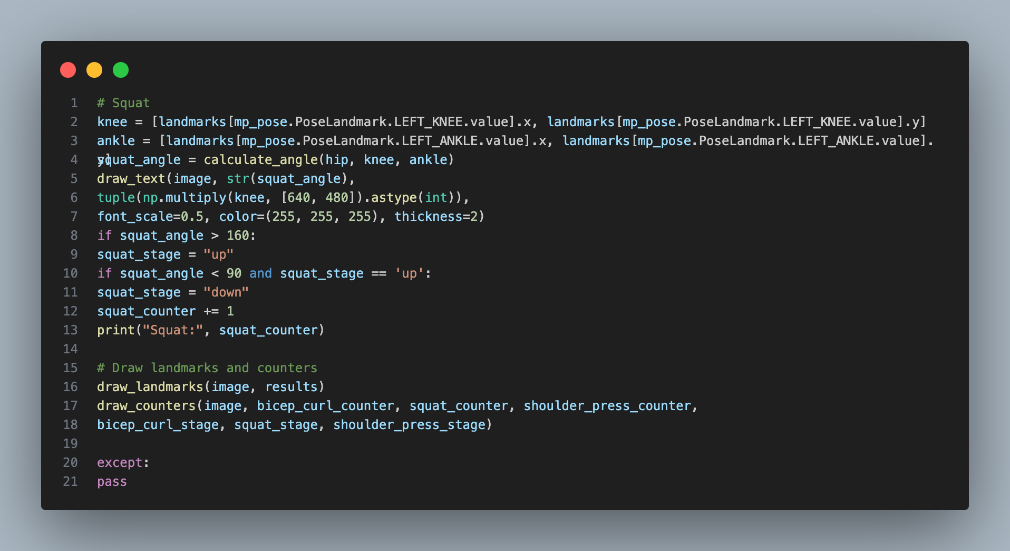
Squat
File Name: main.py
Retrieve the coordinates of knee and ankle
Angle Calculation: Computes the angle at the knee joint to monitor squat movements
Visual Feedback: Displays the squat angle on the video feed
Extension Phase (squat_angle > 160): Indicates the end of a squat repetition
Bending Phase (squat_angle < 90 and squat_stage == 'up): Indicates the start of a new squat repetition
Draw the body landmarks and exercise counters on the video feed to provide real-time feedback to the user

Slide 13
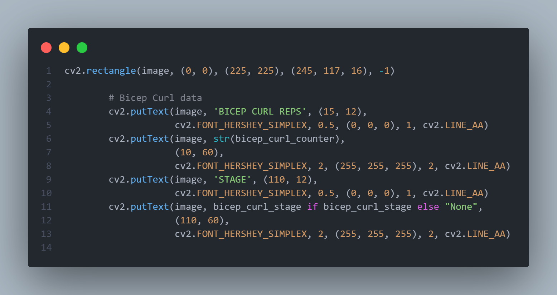
Visuals – Readings
File Name: lib > visual.py
Example : Bicep Curl
Rectangle (box) to show labels/Readings
Show Count of Reps
Show stage (Up or Down)

Slide 14
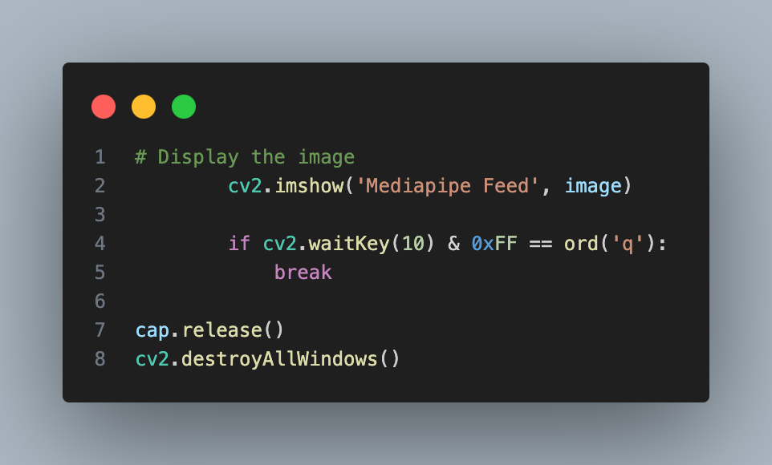
Destroy Video Frame
File Name: main.py
Show Video Frame – Mediapipe Feed
cv2.waitKey(10) : Display the frame for 10 milliseconds
& 0xFF : Ensure that only the lower 8 bits of the result are considered, which is useful for compatibility across different platforms.
ord('q’) : Get the ASCII value of the character 'q’. Check if 'q' key has been pressed. If it has, the loop breaks, ending the video feed.

Slide 15
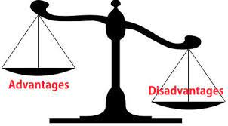
Advantages & Disadvantages
Advantages
Real-Time Performance: designed to work in real-time
Cross-Platform Support: can run on multiple platforms, including mobile (iOS and Android)
Pre-trained Models: Pre-trained models are available, reducing the need for extensive training data
Open Source
Disadvantages
Limited Customization: Customization of the model might be limited
Multiple users issue: Pose detection could be faulty when multiple users in frame

Slide 16
References
OpenCV : https://www.oreilly.com/library/view/learning-opencv-3/9781491937983/ch01.html
MediaPipe : https://ai.google.dev/edge/mediapipe/solutions/vision/pose_landmarker

Slide 17
Thank You!

